Slide 1

GitHub for Blithering Idiots
Team 1559

Slide 2
Git-Who?
Web-based code sharing/tracking software
Great for collaboration
Easy to get others up to speed with commit messages/comments

Slide 3
Jargon
Repository: A “master folder” to store code from a project in
E.G. All of the code related to Potentiometer stuff might be in a repo called pot-stuff
Commit: An official revision to the code to a local repository
Pull: Sync your local repository with the code stored in the mothership
ALWAYS DO THIS BEFORE YOU START WORKING!
Push: Upload your code to the mothership
E.G. Make your changes permanent, and on the internet
DO THIS WHEN YOU’RE DONE WORKING!

Slide 4
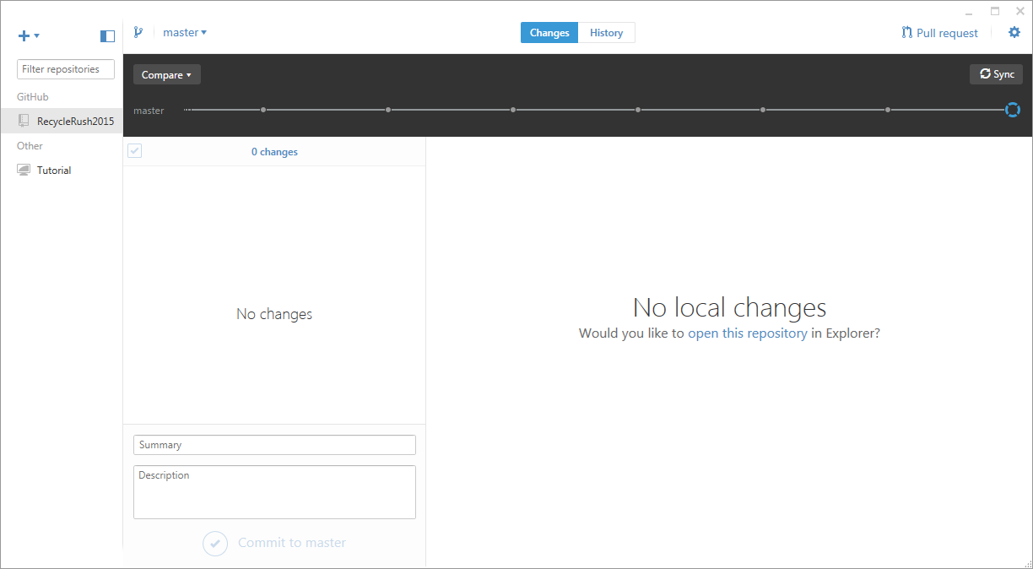
The Windows UI
www.github.com

Slide 5
Creating a New Repository
Daddy, how are repositories made?

Slide 6

Creating a new Repository
Do Create a repository!
DO NOT CREATE A REPOSITORY!!
If you are starting a new project unrelated to existing projects
If you want to start a personal project
If you are proving a concept
E.G. 2-speed chassis
If you are modifying someone else’s code
If you are starting a project for the current competition season
+

Slide 8
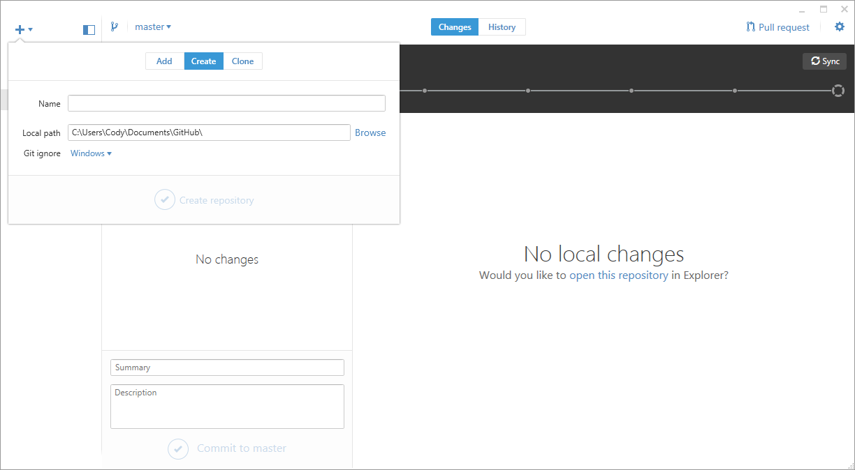

Slide 9
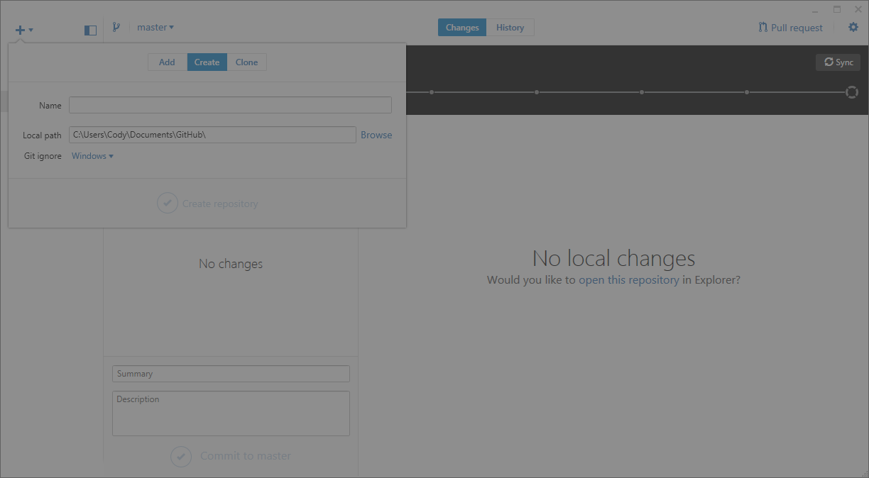

Slide 10
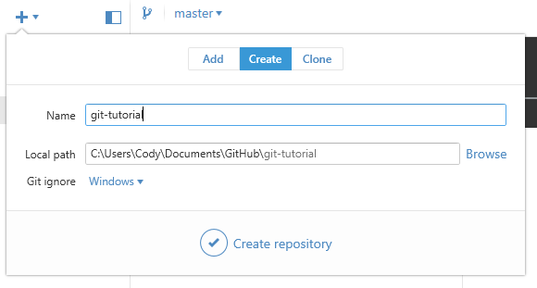
Ensure that Create is selected
Give your repo a nice name:
Generally short, and descriptive
This is OK, unless you want it to make the repository in a specific location
DO NOT TOUCH!
If it looks OK, click Create Repository

Slide 11

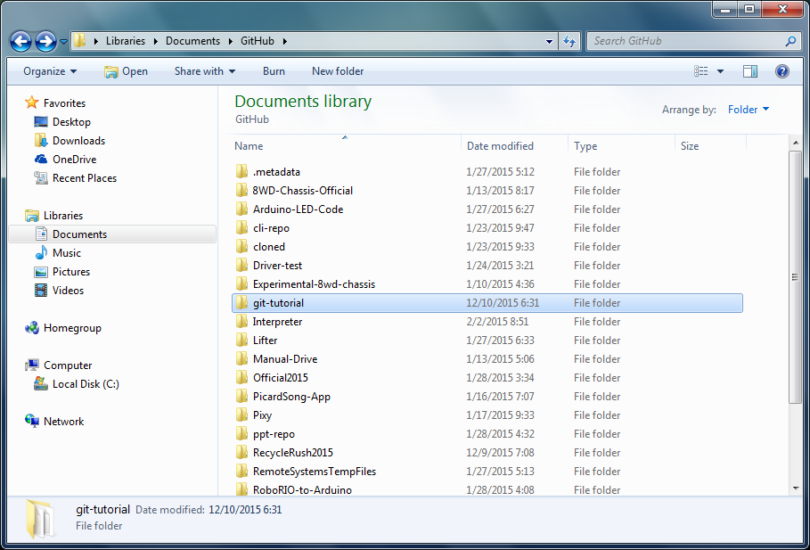
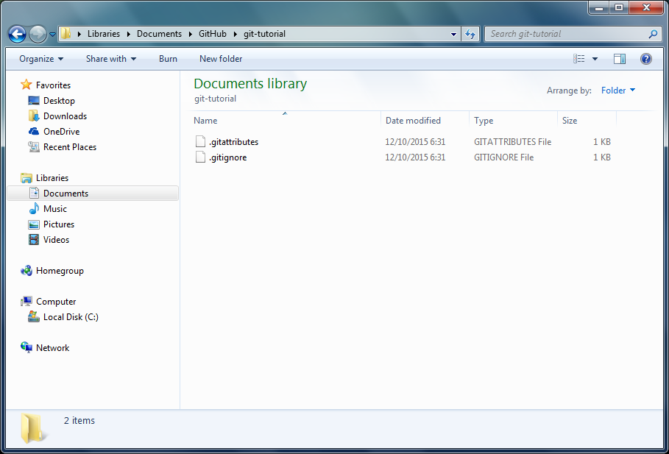
Success!
Now there’s a local repository ready to track your stuff!
Take a look…

Slide 12
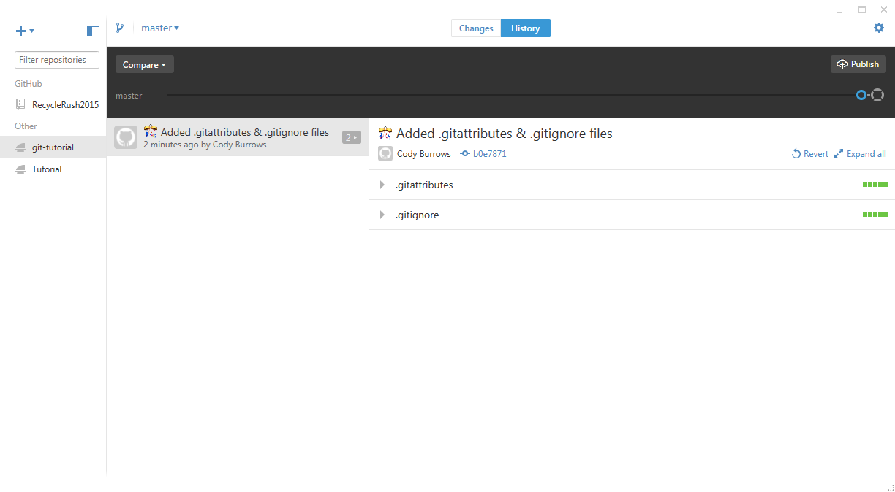
Publishing a Repo

Slide 13
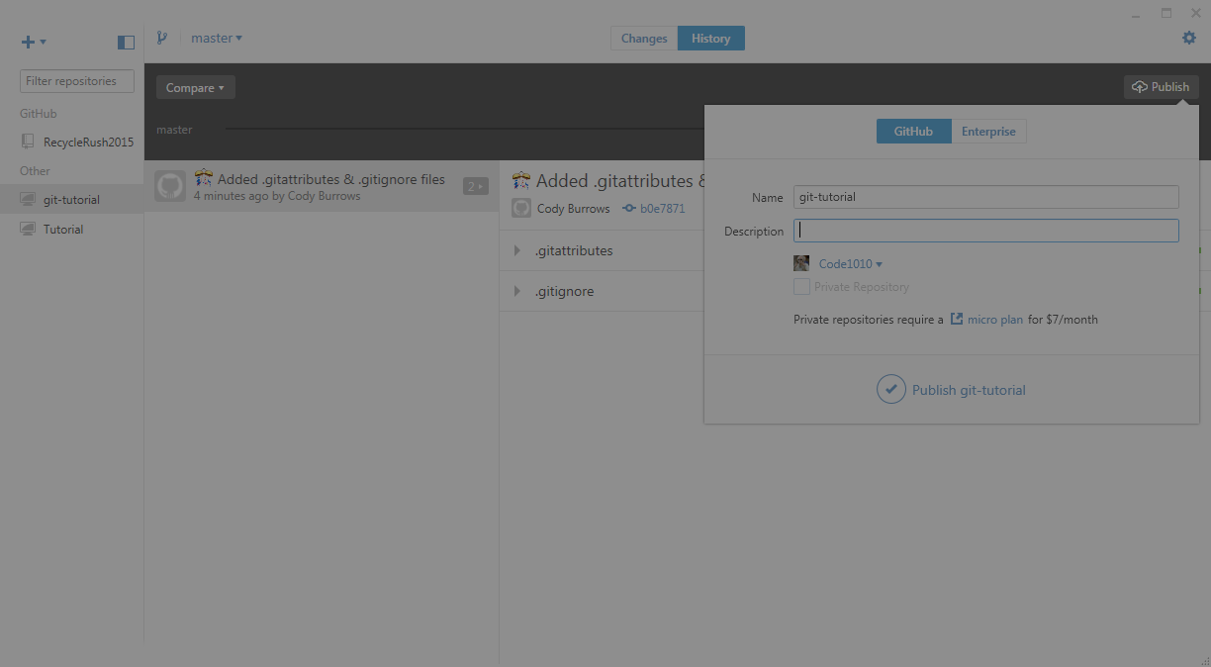
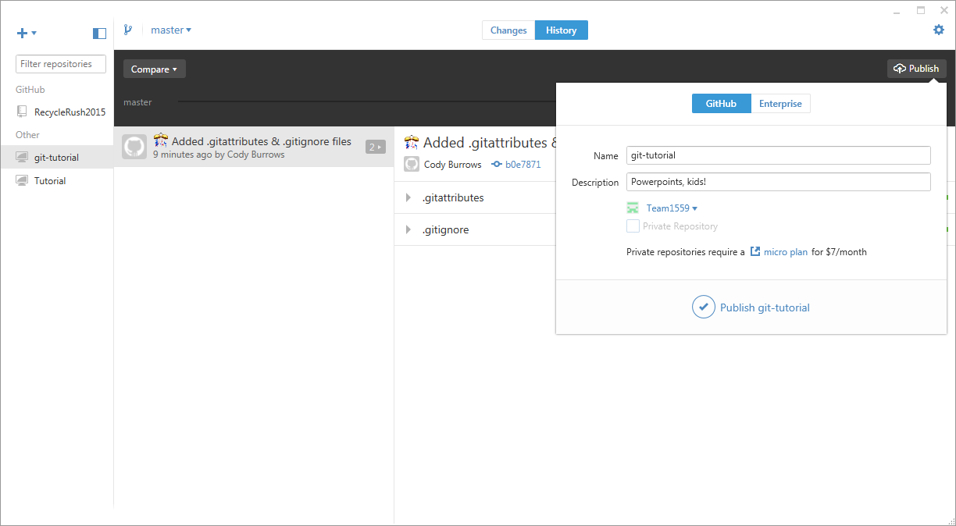
Give your repo a brief description
Select the appropriate account to publish to…
You: Nobody cares
Team1559: Robotics related things!

Slide 14

Celebrate!

Slide 15



Not so fast…
You just created and published an empty repository. ☹
Time to add stuff!

Slide 16
Existing Repo
If you want to add code to an existing repository

Slide 17
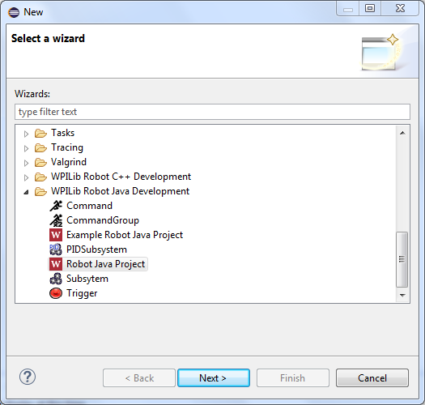
Create a new Eclipse project to track
Select the New Project Wizard
(CTRL+N, Or File > New > Other…)
Select the type of project you want to create
Note: You can simply drag and drop any type of folder or file into the GitHub Repository Directory
Probably this one most of the time!

Slide 18
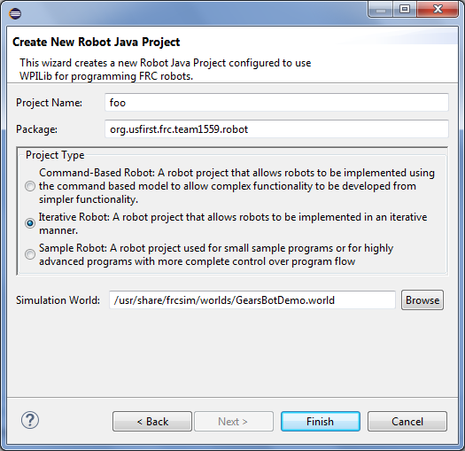
Follow the wizard…

Slide 19
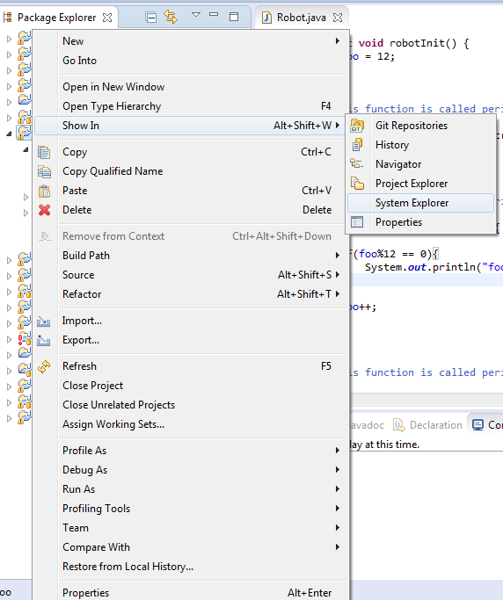
Add the Project to the Repo
Unfortunately, the FIRST provided Wizard for creating new projects does not have functionality to save the project to any location ☹. It saves to the workspace by default. Lucky us!
Right click the project in the Package Explorer in Eclipse
Select Show In > System Explorer

Slide 20
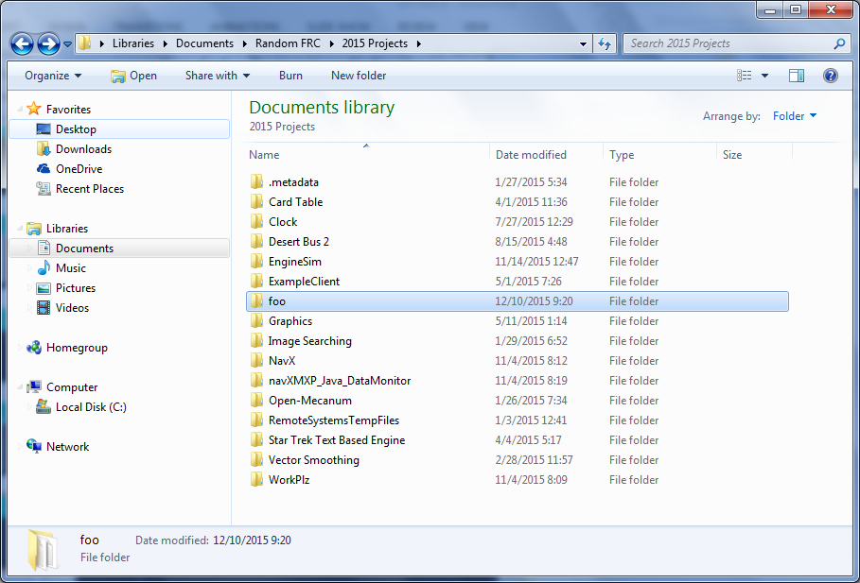
Dump the project into the Repository
Drag and drop the highlighted project folder into your GitHub directory
It’s under My Documents/GitHub/YourRepo

Slide 21

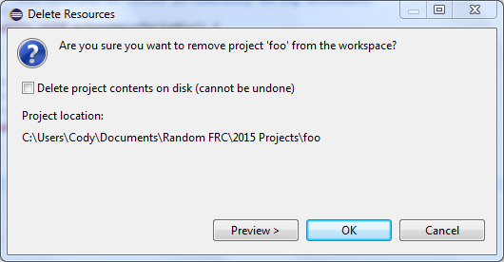
Now delete the project.
Eclipse will get very mad that you changed something.
Ease the pain by deleting and re-adding the project from the new location
Right click project > Delete
Eclipse will puke, but just click OK until the messages close
WHAT?

Slide 22
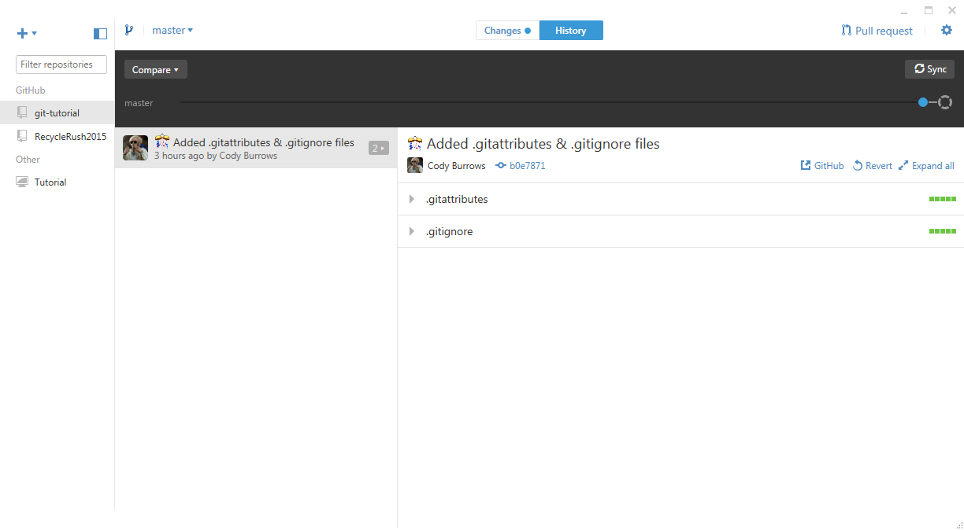
Now check GitHub!

Slide 23
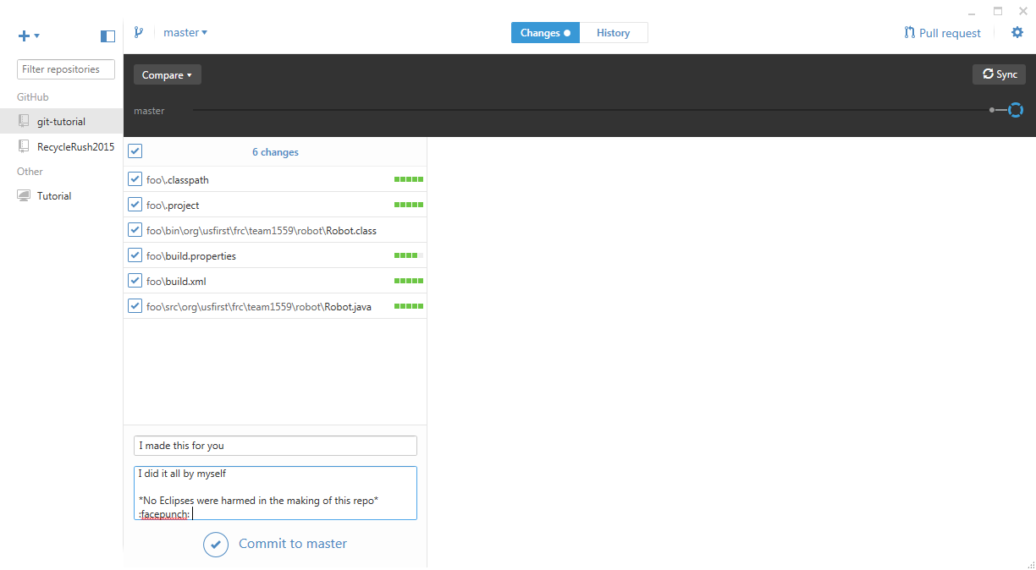
Leave a brief but useful title
Describe your hard work

Slide 24
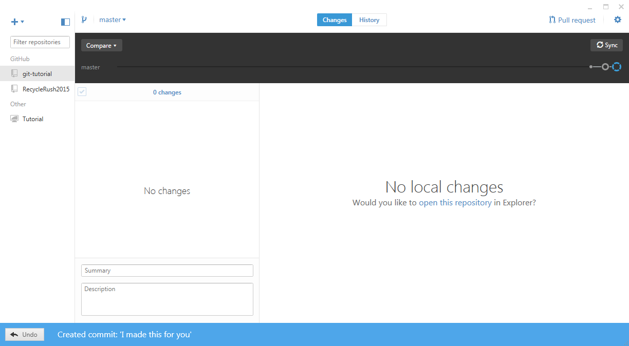
Always sync!!!

Slide 25
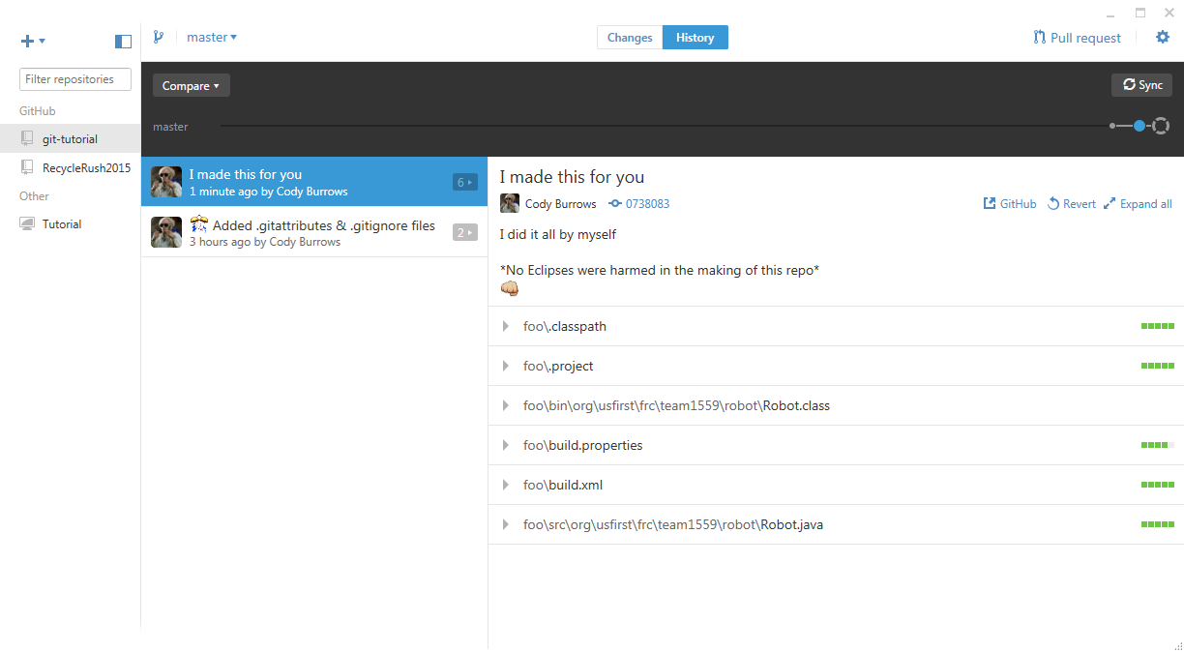
This is the record of all the changes in the history of ever

Slide 26
Re-Adding the project to Eclipse
Make it happy

Slide 27
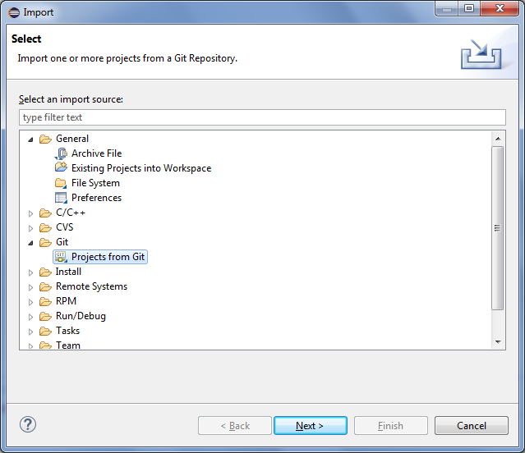
Adding a repository from Git
This is the same process any time you want to add a repo from an existing GitHub Repository
Select File > Import
Choose Projects from Git
Click Next

Slide 28
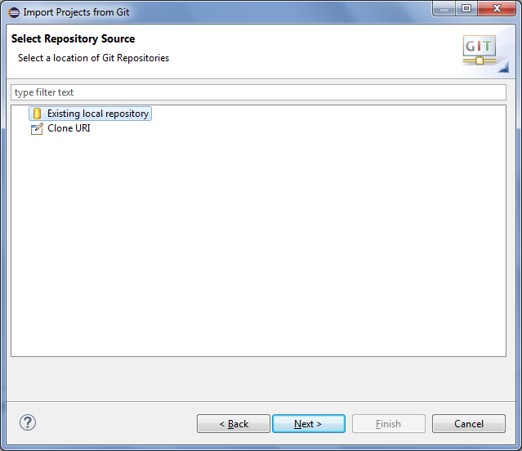
Choose Existing Local Repository

Slide 29
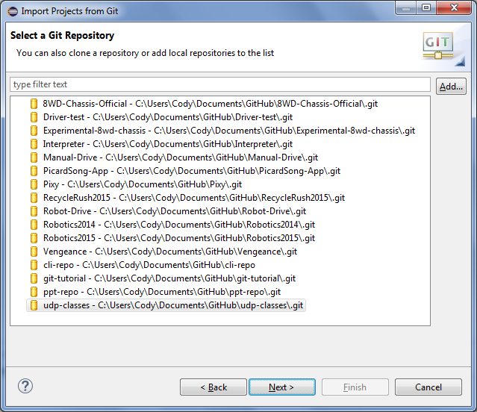
Finding your Repo
If you don’t see your repo listed, click Add in the top-Right Corner
Remember, it’s the Repository Name, not the Project Name
Choose the right directory and click OK
Your repo should be in this list now.
Select it and click Next

Slide 30
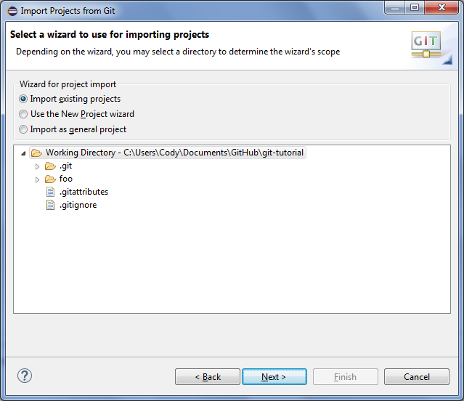
Almost Done!
Make sure Import Existing Projects is selected
Click Next
Click Finish in the next window. It’s useless

Slide 31
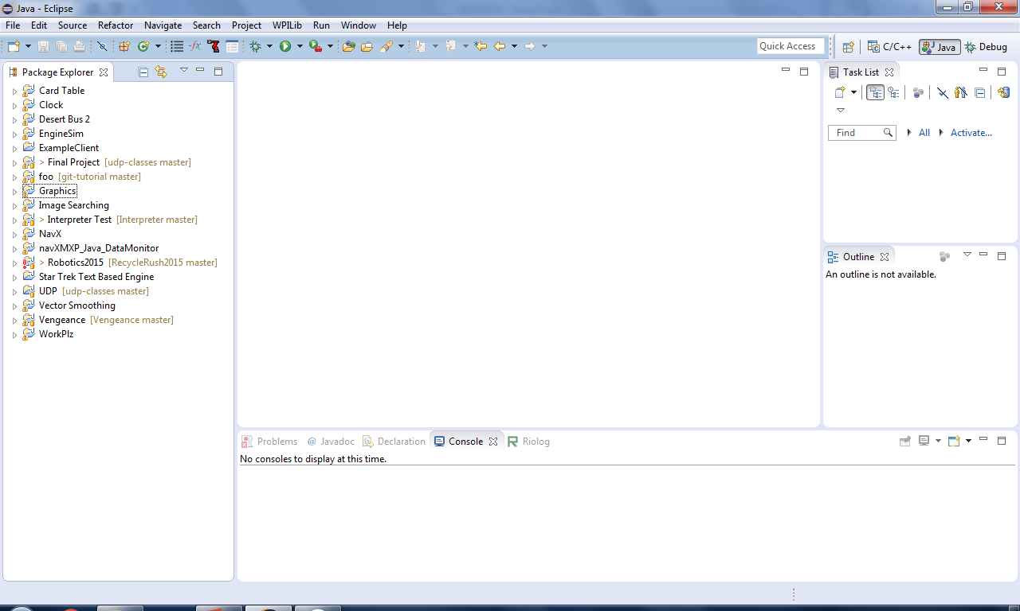
LOOK!

Slide 32
Track Existing code
Creating a repo again!

Slide 33
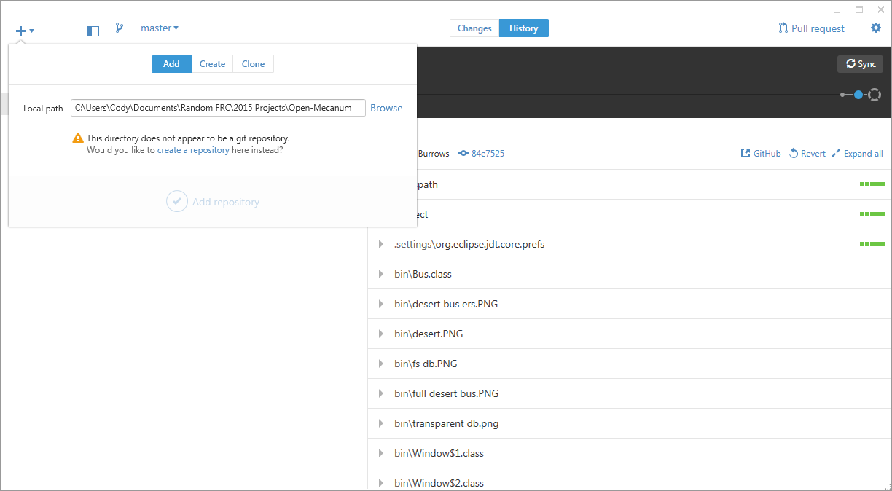

Slide 34
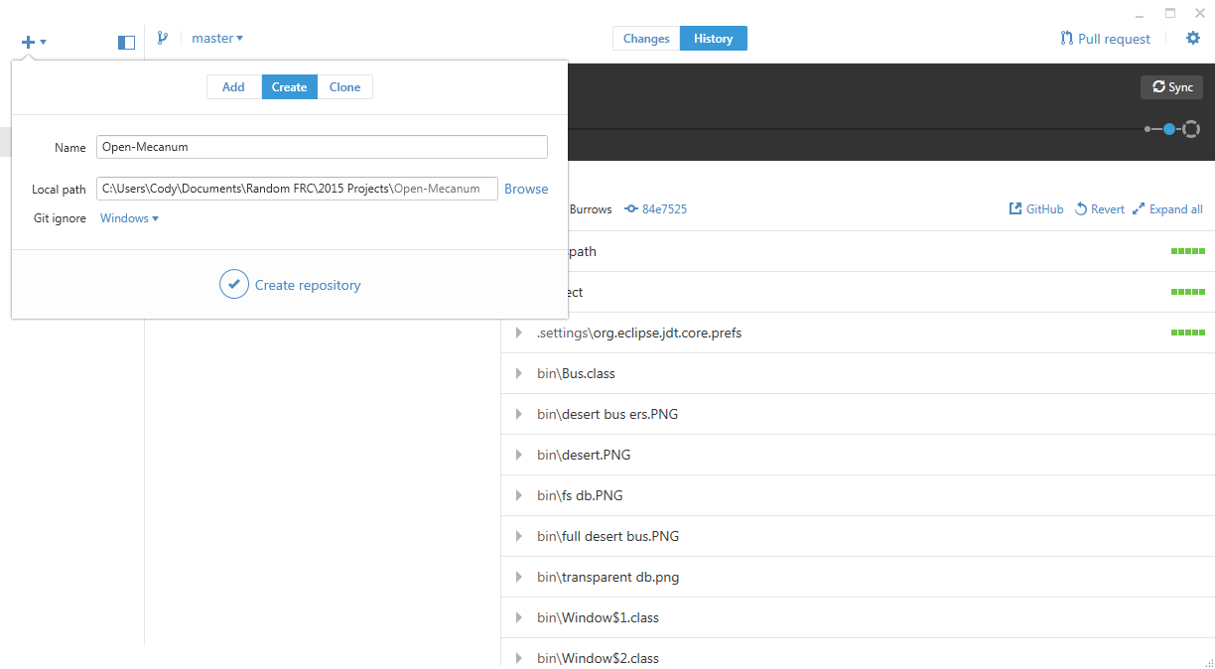
* Don’t forget to commit and publish changes!

Slide 35
Cloning
CTRL+C CTRL+V

Slide 36

“Cloning”
Making a local copy of a remote repository
E.g. You clone the existing RecycleRush2015 repository to edit it

Slide 37


Slide 38
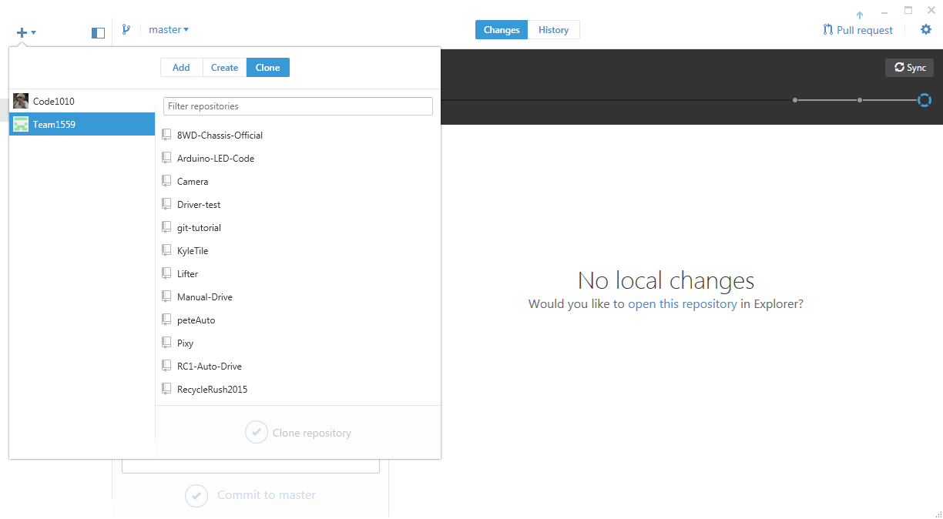
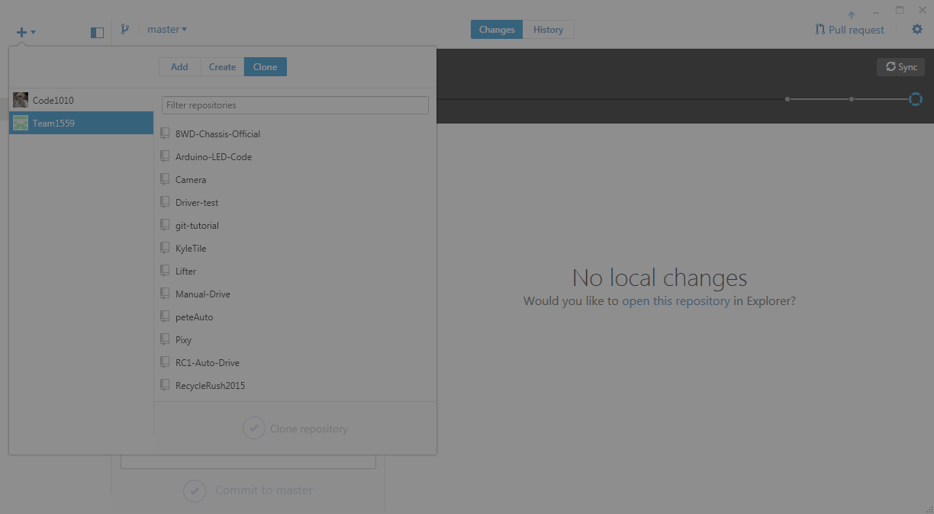

Slide 39
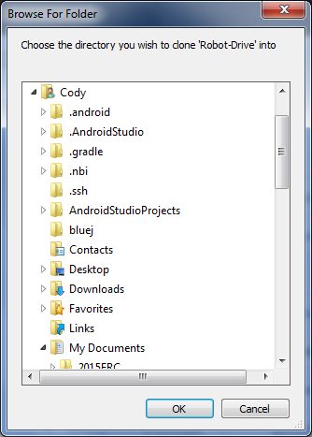
Choose a location that makes sense!
Does it make sense to dump it in your Eclipse Workspace?
GitHub Directory?
Desktop?
Recycle Bin?

Slide 40

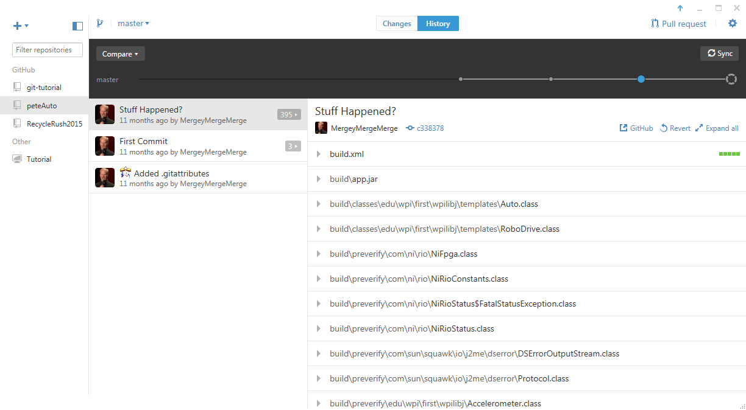
Success!

Slide 41
Branching Out
Like a tree!

Slide 42
Branches
Isolates changes so you can really hack up the code
Do this if you are starting a pretty substantial project based on existing code
The Golden Rule:
The Master Branch is always deployable

Slide 43
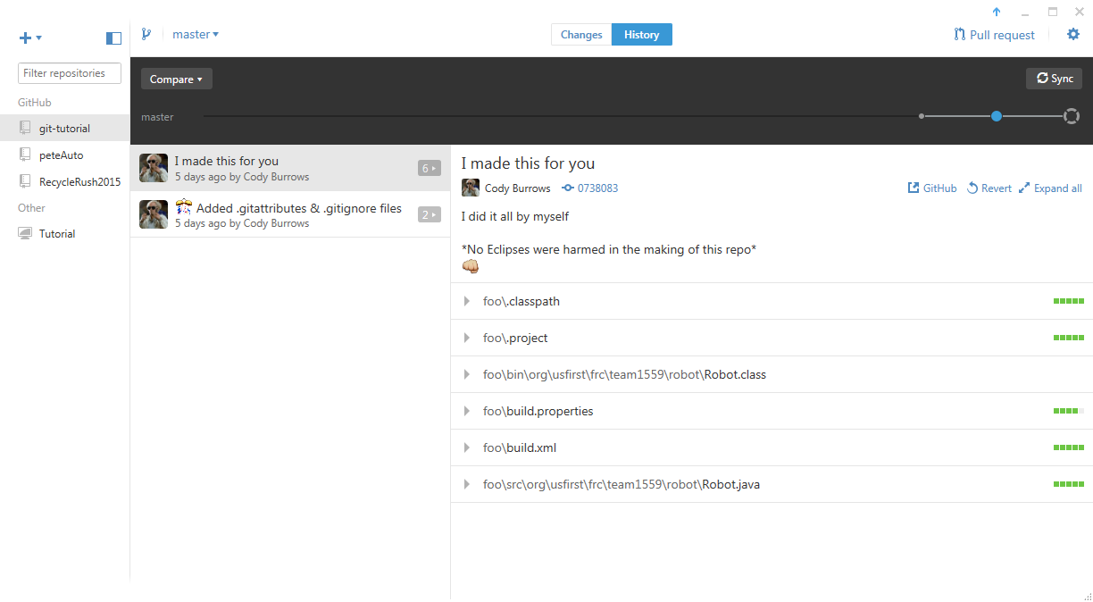

Slide 44
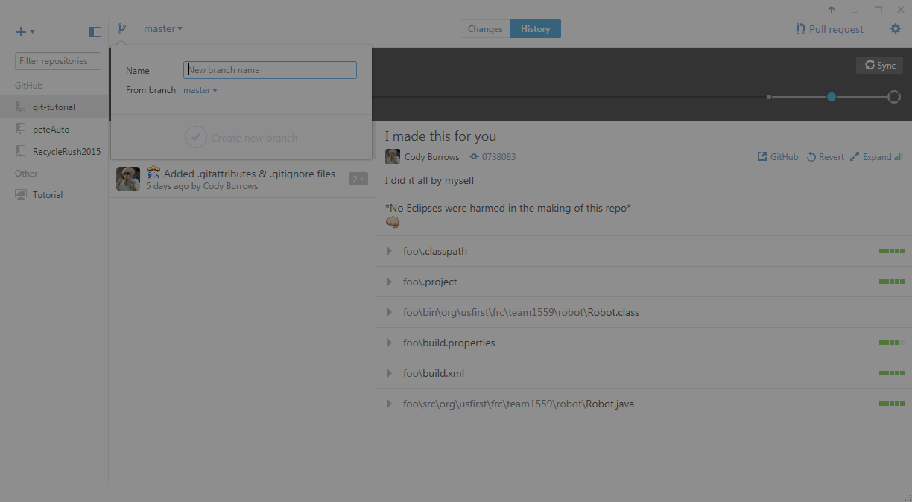
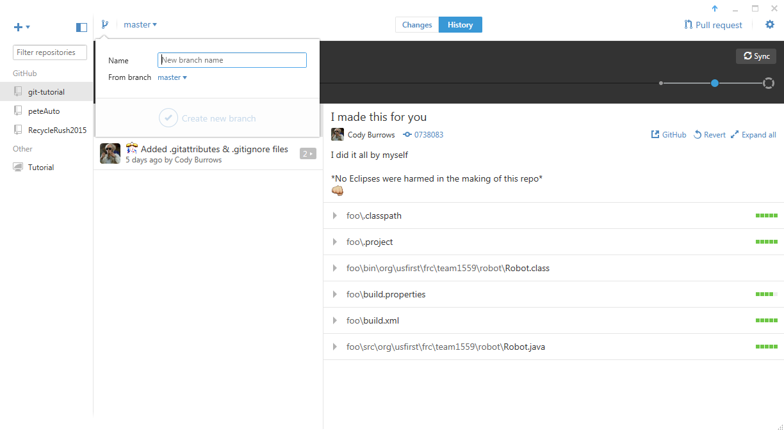

Slide 45

Look!

Slide 46
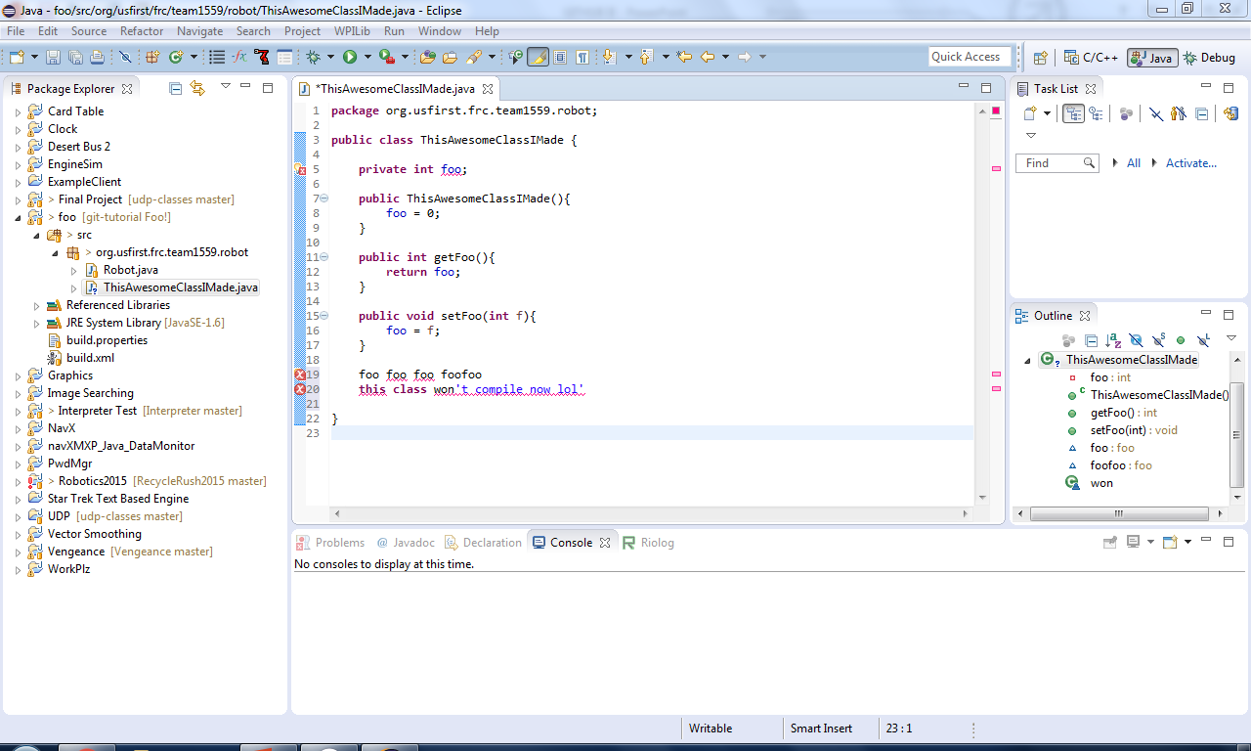

Slide 47
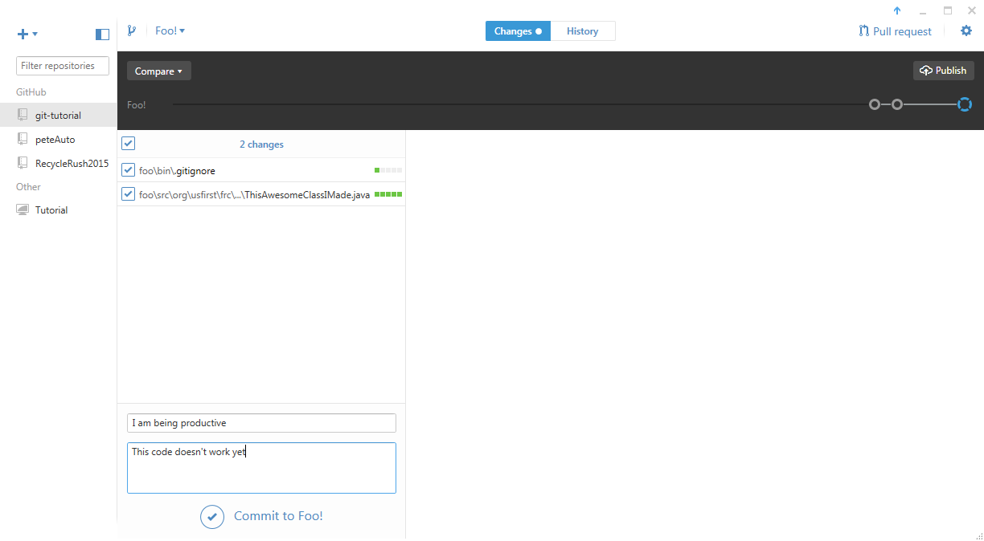

Slide 48


Slide 49
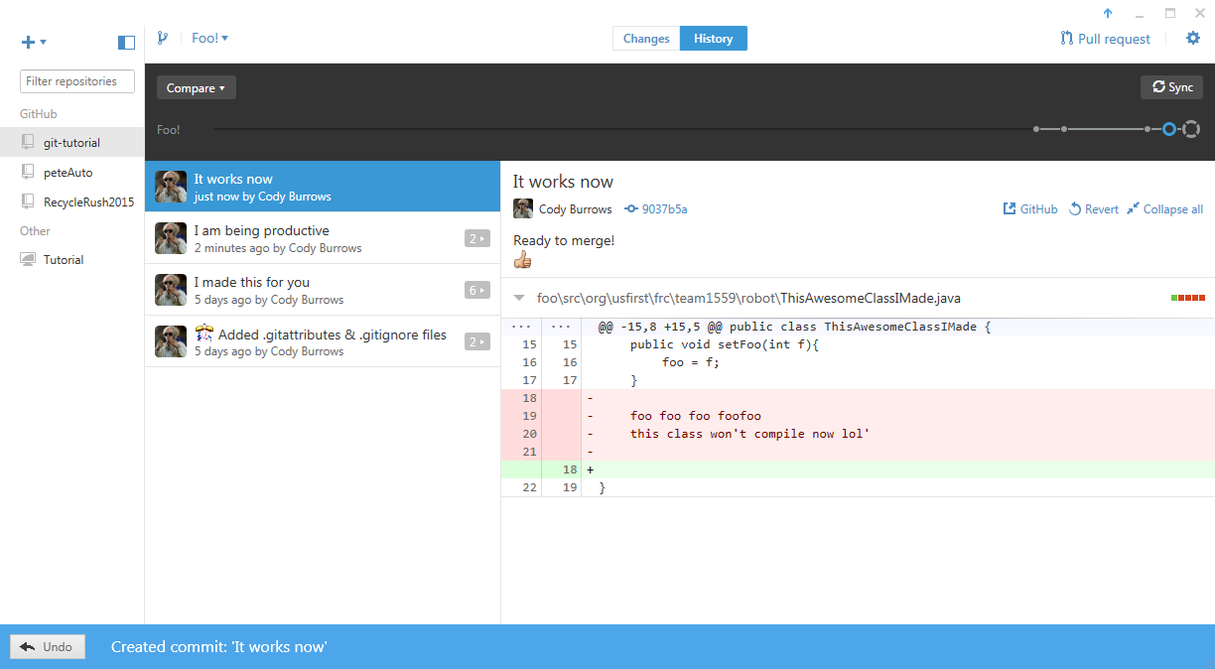

Slide 50
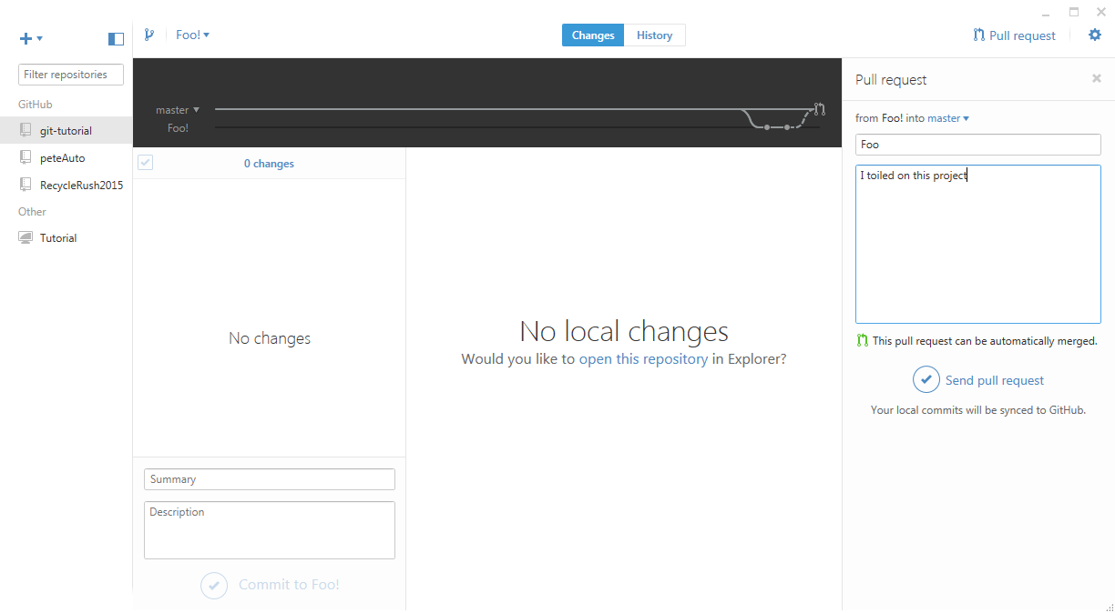
Now, just wait for someone to approve your pull request, and merge the branches!
Awesome!

Slide 51
Reverting
No regrets

Slide 52
Reverting changes
The best way to avoid conflicts and mistakes is by not making them in the first place.
Find the last ‘good’ version of the code
Click revert

Slide 53
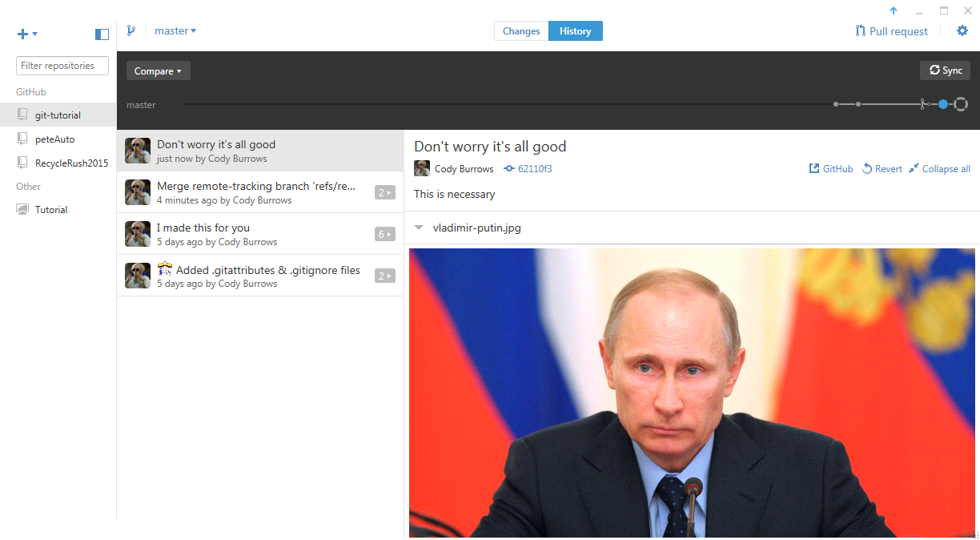

Slide 54
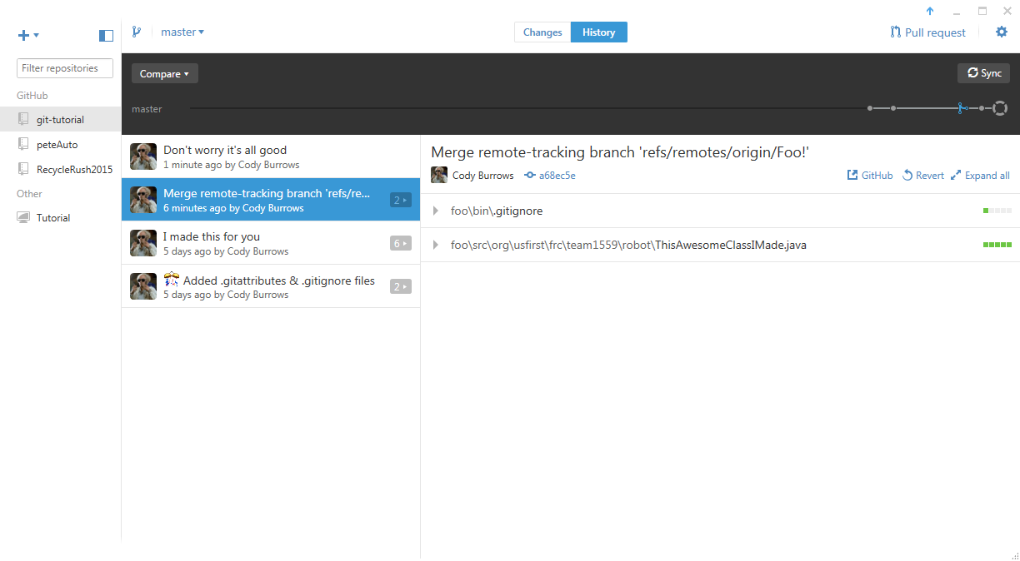
Always ask first!
This is a bad example…
You can’t revert to a merge

Slide 55
Reminders
GitHub is not stupid proof

Slide 56
Pull then Push [it real good]
ALWAYS sync to make sure your local version of the repository is up to date with the version that’s stored in the mothership before you start working. This is called “pulling”, which is a command in the Git Shell
ALWAYS commit your changes, and sync them back up to the cloud version, so there aren’t discrepancies. This is called pushing, a Git Shell command, and a popular Geico Commercial

Slide 57
Don’t Fork it up!
There’s not really a good reason to fork the repository.
Forking is the operation of creating a new repository pre-stuffed with the contents of another repository.
For example, if I wanted to make a better version of windows, I could fork the windows repo so I have my own copy to hack up. Microsoft’s version of their windows repo is unaffected my any meddling I do

Slide 58
Good Luck!
Happy gitting!

